Slide 1
Day 1 Agenda
Introduction to Strategic Planning in Content Marketing
SMART Goals
Budget Allocation
Presentation Working Time
Common Mistakes

Slide 2
Content Marketing Planning & Analysis
Day 1 Synchronous Session

Slide 3
Our days will always consist of
A 10 minute break every 50 minutes
A 45 minute lunch (when we want it)
Lecture
Interactive activities and exercises
Work time for the presentation

Slide 4
Before we get started...
Please share your
Name,
Background, and
What you’re hoping for from our two (2) day session.

Slide 5
Check in:
How has this course, and this program, been for you so far?

Slide 6
Case Study
This is Kyley Paul.
She started Coaching with Kyley.
She specializes in executive coaching for high performing entrepreneurs.
She sells coaching hours, packages, products and courses.

Slide 7
Case Study
She came to me and asked
“How should I be using Pinterest?”
How would you answer this question?
How do you think I should have answered?

Slide 8
Case Study
This situation requires strategic planning that ultimately impacts marketing, sales, operations and more.
Kyley will be our baseline case study for the day.

Slide 9
Strategic Planning
Strategic planning has wildly been abused, misused and ill defined.
From Catherine Cote of Harvard Business School, “Strategic planning is the ongoing organizational process of using available knowledge to document a business's intended direction. This process is used to prioritize efforts, effectively allocate resources, align shareholders and employees on the organization’s goals, and ensure those goals are backed by data and sound reasoning.”
(Cote, 2020)

Slide 10
Strategic Planning
Strategic planning has wildly been abused, misused and ill defined.
From Catherine Cote of Harvard Business School, “Strategic planning is the ongoing organizational process of using available knowledge to document a business's intended direction. This process is used to prioritize efforts, effectively allocate resources, align shareholders and employees on the organization’s goals, and ensure those goals are backed by data and sound reasoning.”
(Cote, 2020)

Slide 11
Strategic Planning
Ongoing organizational process: Affects the whole business
Documented: Somewhere tangible multiple people can access it.
Prioritized efforts: In chronological order, usually with recommendations on when/how to make decisions.
Aligned shareholders: Everybody agrees and works to the same things.
Backed by data: A lot of marketers have “ideas”, but those ideas need to be rooted in fact.

Slide 12
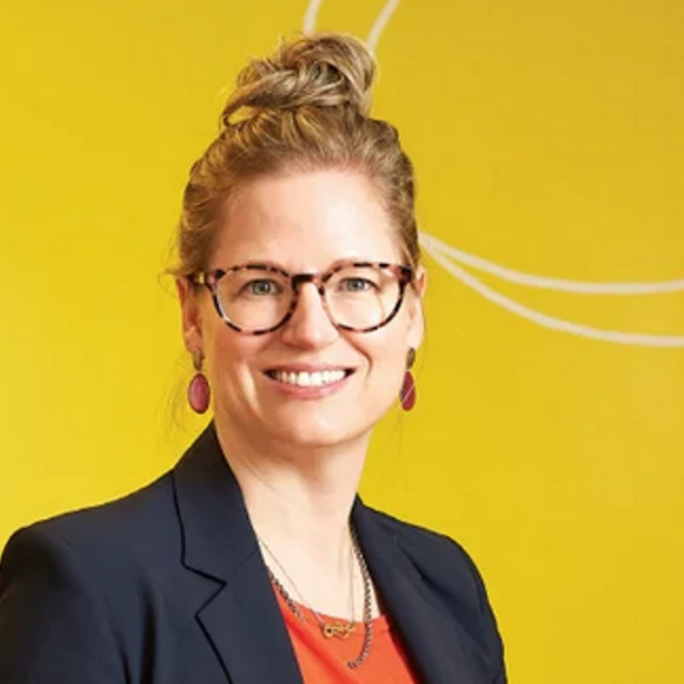
Strategic Planning
This is Kristine Beese from Untangle Money.
I worked with her to develop a comprehensive social media marketing strategy for her business.
The whole process took about ten (10) hours. But understanding the business strategy, goals and priorities took about three (3) hours.
That’s how important strategic planning is to social media marketing.

Slide 13
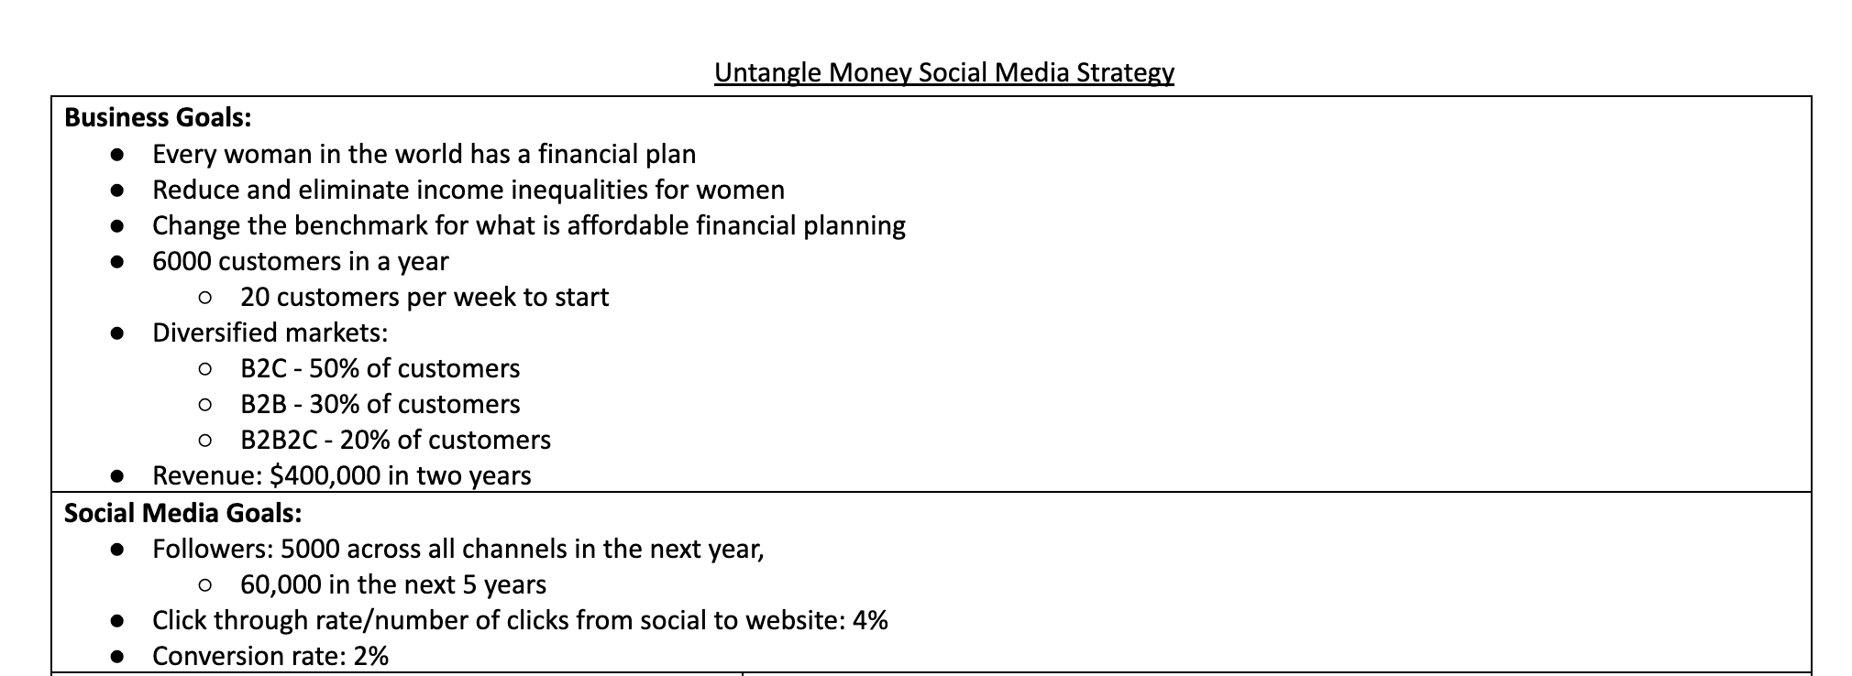
Strategic Planning

Slide 14
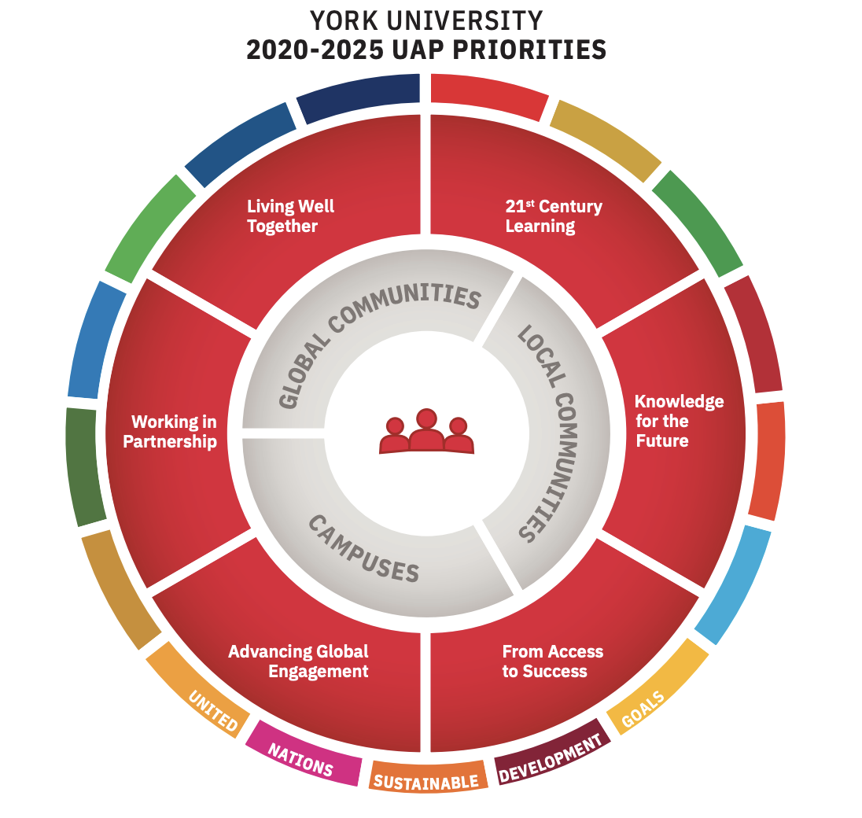
Strategic Planning
Cool Example: York University
York University has publicly published their strategic plan (which they call their University Academic Plan, or UAP)
Let’s review the parts to see how high level it is and the documented process
https://vpap.info.yorku.ca/files/2020/06/Building-a-Better-Future-YorkU-UAP-2020-2025.pdf

Slide 15
Strategic Planning: Discussion Session (10 minutes)
In breakout rooms, choose a company and discuss what you think they’d include include in their strategic plan.
You can do research if you want, you can use company suggestions, but I also want to see what you think should be included.

Slide 16
Strategic Planning: Discussion Session 2 (15 minutes)
Now that you’ve picked a company and thought about strategic plans....
How do you think strategic plans affect or influence content marketing?
Discuss, and if time permits, come up with content ideas from the strategic plan.

Slide 17
How Strategic Planning Can Affect Content Marketing
Content governance (what is posted, how it’s posted, voice, tone, subject matter)
Areas of promotion (sales metrics, and social media metrics that help achieve sales metrics)
Value add topics (it’s not all about selling, we have to delight as well!)
Other opportunities for growth (ex: influencers, paid ads, target audiences and centres of influence)

Slide 18
How Strategic Planning Can Affect Content Marketing
Your strategic plan determines your priorities.
How do you prove what your priorities are? Priorities are demonstrated by where you spend your money.

Slide 19
How Strategic Planning Can Affect Content Marketing
Final break out session on Strategic Planning:
In your assigned groups, discuss what you think the strategic plan is for your company, and how you may allocate budget to support your strategic plan.
Notes:
Don’t stress about getting this perfect, it’s a simple primer for further conversations.

Slide 20
How Strategic Planning Can Affect Content Marketing
Before answering Kyley’s question about Pinterest, I checked on her strategic plan.
What was she trying to achieve?
What direction was her work going?
Did she have the resources needed, and was she okay allocating them to new efforts?

Slide 21
SMART Goals
SMART is a common methodology used to make sure we do things we intend to do. SMART is an acronym for
Specific
Measurable
Achievable
Realistic
Timely
(Corporate Finance Institute Team, 2022)

Slide 22
SMART Goals
SMART Goals are often taught in the form of a chart:
S | M | A | R | T
Specific part of the goal. | Measurable part of the goal | Achievable part of the goal | Relevant part of the goal. | Timely part of the goal.
This is inaccurate.
SMART Goals are written as a statement, usually one sentence, no more than three.

Slide 23
SMART Goals & Strategic Planning
A SMART Goal we may right for Coaching with Kyley is:
Attract 15 new coaching
clients (a 20% increase) in
the next six months for hourly coaching.

Slide 24
SMART Goals & Strategic Planning
A SMART Goal we may right for Coaching with Kyley is:
M
Attract 15 new coaching
clients (a 20% increase) in
the next six months for hourly coaching.
A
R
T
S
Notes:
See it doesn’t literally go S then M then A then R then T

Slide 25
SMART Goals
Note: there are two (2) types of goals, both are fair and valid:
Outcome based goals are things that happen to you (like followers, sales).
Behaviour based goals are things you do and get credit for based on an observable behaviour.

Slide 26
SMART Goals & Content Marketing
A content marketing goal we may set for Kyely is:
Test a new offering by creating and posting six new Instagram reels highlighting the benefits of coaching in the next two weeks.

Slide 27
SMART Goals
Write yourself a SMART Goal.
It can be related to anything in your life!
Then we’ll share.

Slide 28
SMART Goal Group Exercise
In your assigned groups, please create a SMART goal for your company’s campaign.
Be prepared to share, review and discuss!

Slide 29
Budget Allocation
You have to pay for things!
While a lot of content marketing can be bootstrapped, there is budget involved.
Budget though also helps reveal priorities, goals and calculate return on investment.

Slide 30
Build a sandwich with $13.
Budget Allocation Game
Breads | Toppings | Garnishes
Plain White - $3 | Salami - $4 | Mayo $1
Whole wheat brown - $4 | Bologna - $4 | Mustard $1
Specialty ciabatta - $5 | Mozzarella Cheese - $3 | Butter $1
 | Cheddar Cheese - $2.50 | Ketchup $1
 | Bacon - $4 | Pickle on top $3
 | Lettuce - $1
 | Tomato - $3
 | Onion - $2
Notes:
You only have $12. What do you put on your sandwich? Have fun with it.
Post in the chat your total and what’s on your sandwich.

Slide 31
Build a sandwich with $9, and you must choose at least one item from each category;
Budget Allocation Game
Breads | Toppings | Garnishes
Plain White - $3 | Salami - $4 | Mayo $1
Whole wheat brown - $4 | Bologna - $4 | Mustard $1
Specialty ciabatta - $5 | Mozzarella Cheese - $3 | Butter $1
 | Cheddar Cheese - $2.50 | Ketchup $1
 | Bacon - $4 | Pickle on top $3
 | Lettuce - $1
 | Tomato - $3
 | Onion - $2
Notes:
More difficult with scarcity.
Post in the chat your total and what’s on your sandwich.

Slide 32
Budget Allocation
A key component of budget allocation in content marketing (and all business, for that matter) is scarcity.
Rarely will you ever get everything you want.
This is why we have to determine priorities so we know better how to make decisions.

Slide 33
Budget Allocation Brainstorm
What are all the different things we could have to pay for in content marketing?
Notes:
Annotate this slide!

Slide 34
Things We Can Pay for in Content Marketing:
Employees (if outside regular time) | Contractors | Design Technology | Editing Technology
Photographers | Models | Hair / Make Up | Set & location
Props and set up | Influencers | Assets | Product Modifications
Retreats & Planning time | Research and analysis | Rights and licensing | Writers
Videographers | Video production staff | Re-touchers | Equipment
Notes:
This is a huge list so you know lots of options to choose from.
Technology: Canva Pro, Adobe photoshop/lightroom/illustrator
Editing = Premier
Assets = sometimes the person who created the content owns it
Rights and licensing if you use any stock stuff

Slide 35
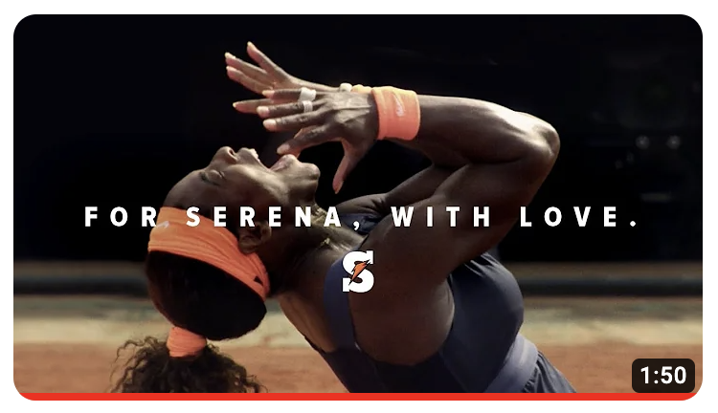
Budget Allocation: Reflection Activity
What do you think this company paid for to produce this commercial?
https://www.youtube.com/watch?v=sLzYLs3aUT4

Slide 36
Budget Allocation : Goal Matching
We can’t just spend money on things!
We have to justify our budget choices.
Easiest way to justify budget choices? Connecting something we’re buying or using with a strategic priority or goal.

Slide 37
Budget Allocation : Goal Matching
In Kyley’s business, we determined two key strategic priorities:
Make more sales.
Determine which products or services are more popular.
Because this is heavily product focused, it made sense to focus on Pinterest content that can also sell (and setting up ability to sell)

Slide 38
Budget Allocation : Goal Matching Examples
We want... | Which means we may try... | Which means we pay for....
Exposure to new audiences | Influencer marketing | Influencers
Brand recognition and top of mind recall | Creating savable graphics | A graphic designer to make assets for us
To understand which content converts most often | Deep data analysis and action planning | A consultant to help

Slide 39
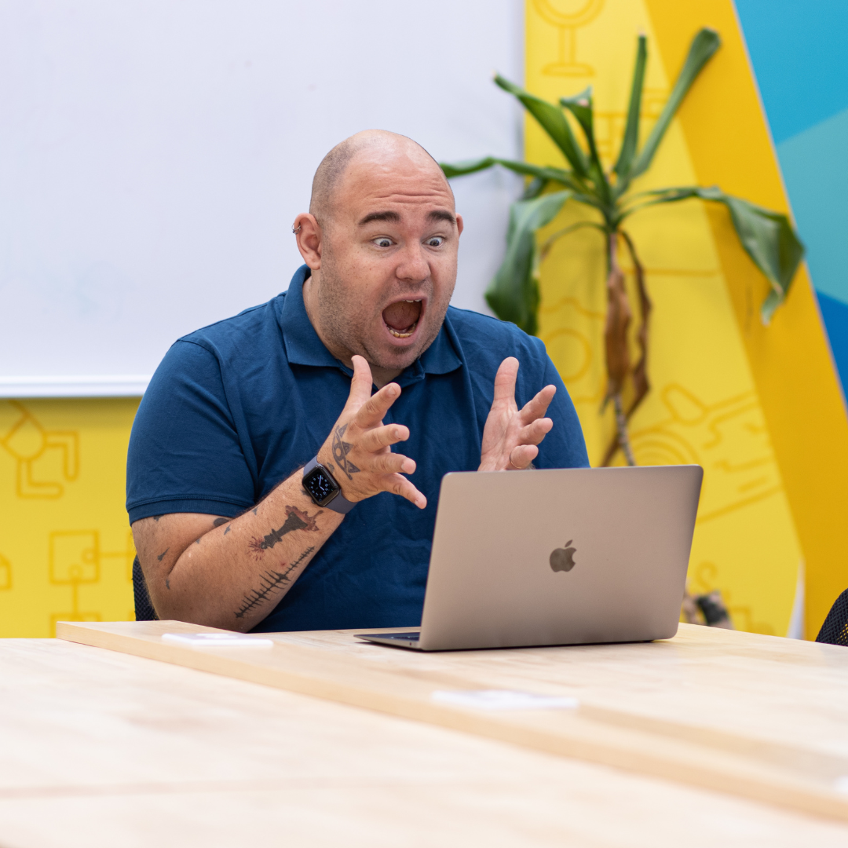
Stump the Expert Time!
Give me any business, strategic or content marketing goal, and I’ll tell you things you’ll have to allocate in your budget.

Slide 40
Budget Considerations
Here’s some guiding questions, ideas or principles that may help allocate your budget:
Is this a need or a want?
Can I get it cheaper, without compromising quality?
Do I need anything else to make this useful?
What goal, or part of our goal, does this budget item help us achieve?
Will I be able to use this later?

Slide 41
Budget Considerations
Budget is also about priorities.
What other questions would you ask, or what things would you consider, when budgeting for content?

Slide 42
The Problem with Pricing in Marketing
Pricing varies greatly in almost every aspect of marketing. Pricing will be affected by
Who provides the quote (an agency? A freelancer?)
Where the person is located*
What competition is like
The scope of practice and requirements
This is when it helps to form relationships and set benchmarks for prices.
Notes:
*for example, a Toronto based portrait photographer is probably going to be cheaper than a portrait photographer in North Bay Ontario

Slide 43
Photographers: One of, or combination of
Base fee just to show up and shoot
Images
Licensing and rights
Pricing Models
Bloggers:
Per word
Per project (written piece)
Additional fees for research
Influencers
What kind of post is being done

Slide 44
Videographers: One of, or combination of
Base fee just to show up and shoot
Amount of editing (or, raw files)
Licensing and rights
Pricing Models
Graphic Designers
Retainer
Per project (multiple assets)
Per item created
Models
Day of fee
Licensing and rights

Slide 45
Pricing Models: Research Task
Please take fifteen (15) minutes to research and share the prices you found for the below items:
A Vancouver based | A Guelph based
Photographer |  | Photographer
Copywriter (blogs) |  | Copywriter (blogs)
Graphic Designer |  | Graphic Designer
Notes:
This isn’t about “getting it right”, it’s about finding a range as a class

Slide 46
Budget Considerations
Say York University does a campaign, and in their campaign they create
One image,
With one student,
From a foreign country,
With a quote on it,
Highlighting the international student experience.
What do you think they paid for? Let’s use this to wrap up the conversation with scarcity.

Slide 47
Budget Considerations
Chances are they paid
A photographer (who also edited),
The licensing fees,
Something (fee or honorarium) to the student,
Graphic designer to put this together and make sure it can be printed
For ads to distribute this in foreign countries.

Slide 48
Budget Considerations
Chances are they paid
A photographer (who also edited),
The licensing fees,
Something (fee or honorarium) to the student,
Graphic designer to put this together and make sure it can be printed
For ads to distribute this in foreign countries.
If you could only choose three (3) of these things, which would you choose? Why?

Slide 49
Budget Considerations
Chances are they paid
A photographer (who also edited),
The licensing fees,
Something (fee or honorarium) to the student,
Graphic designer to put this together and make sure it can be printed
For ads to distribute this in foreign countries.
If you could only choose two (2) of these things, which would you choose? Why?

Slide 50
Working Time: Budget
Take twenty (20) minutes to work on your budget for your presentation.
I will visit and check in to help.
After, we will come back to talk about the presentation requirements and next steps.

Slide 51
Presentations
Tomorrow you will do presentations on your campaigns! In it you will
Speak for 15 minutes and
Discuss your company and the campaign you chose, as well as essentially
How you’d go about planning for, and delivering on the campaign.
You’ll then hand in a proposed budget to support your plan, with rationale.

Slide 52
Presentations
Generally, I’m a really easy grader as long as you at least try, and have justified your choices
You choose who speaks or how it’s delivered
You can get your mark for your presentation right at the end (as I grade in real time).

Slide 53
Presentations: The Written Component
The written and submitted component should have two (2) parts:
The budget (will probably look like a table)
Rationale (1-2 pages)
What I’m really evaluating: can you defend your choices with evidence?
Just use evidence. Move behind just having ideas to justifying your choice.

Slide 54
Presentations: Working Time
You now have one hour to work on your presentations and reports. Build in a 10 minute break to this time.
I’ll pop into your rooms to check in on you, or you can come to the main session for help.
After this we’ll wrap up with common mistakes and a debrief.

Slide 55
Common Content Marketing Mistakes
A key skill involved in identifying strong, and not-so-strong content is called conscious consumption.
Conscious consumption is the intentionally slowing down and considering parts of content marketing.
This is how we can tell “common mistakes”.

Slide 56
Common Content Marketing Mistakes
Take three (3) minutes, choose one social media platform, and scroll.
Identify either a really strong post, or a not-so-strong post.
Be prepared to share: what made it a good or bad post?

Slide 57
Common Content Marketing Mistakes
No point
Generic
No value
Too much going on
Doesn’t support any business goals
Doesn’t identify or move people through the marketing funnel
No alignment with what the algorithms like
Notes:
No point: post that said “make the most of today” and I commented “okay”
Generic: avoid use of stock photography

Slide 58
Common Content Marketing Mistakes: Kyley Example
She, like a lot of coaches, was guilty of bland, non-helpful content
We moved her and her Pinterest strategy to graphics that teach a concept

Slide 59
Case Study
She came to me and asked
“How should I be using Pinterest?”
How would you answer this question?
How do you think I should have answered?

Slide 60
Day 1 Recap
We explored strategic planning, a process that sets a direction for the whole organization and then chooses tactics from there that support the direction.
We identified the key parts of SMART goal statements, and that it’s not always a linear statement through S → M → A →R → T
We wrestled with all things we have to pay for in content marketing and how we may handle scarcity.

Slide 61
Day 1 Recap
We developed our presentations and hand-documents on budget.
We discovered what can make strong or not so strong content through conscious consumption.

Slide 62
Debrief
Learning is a democratic process, and you get a hand in it too! Help shape tomorrow and future classes by sharing three (3) answers:
What did you like from today, that you’d like in future classes?
What didn’t you like from today, that you’d change in future classes?
Do you have any other notes or feedback for me?

Slide 63
Day 2 Agenda
Introduction to Buyer Personas
and Journey Mapping
Building Effective Personas
Presentation Working Time
Matching Content to Buyer to Journey
Presentations!

Slide 64
Content Marketing Planning & Analysis
Day 2 Synchronous Session

Slide 65
Our days will always consist of
A 10 minute break every 50 minutes
A 45 minute lunch (when we want it)
Lecture
Interactive activities and exercises
Work time for the presentation

Slide 66
Before we get started...
Please share
How you’re feeling about today,
One thing about digital marketing interesting to you, and
Something you hope we explore today.

Slide 67
Check in:
Is there anything you feel we should review, or any questions you may have?

Slide 68
Case Study
This is Kyley Paul.
She started Coaching with Kyley.
She specializes in executive coaching for high performing entrepreneurs.
She sells coaching hours, packages, products and courses.

Slide 69
Case Study
She came to me and asked
“How should I be using Pinterest?”

Slide 70
Case Study
This situation requires understanding her target audience, how they (can) buy and what we can act upon. From there we can develop content strategies.

Slide 71
Buyer Personas
A buyer persona is a fictional character created by marketing departments to identify, communicate and act upon people most likely to purchase a product or service quickly.
(The Shopify Team, 2022)

Slide 72
Buyer Personas & Target Audiences
You may also hear this referred to as audience segmentation.
Audience segmentation is broader, and applies to a whole group of people.
Usually, companies have both. However, the buyer persona is usually more specific, accurate, prescriptive and leads to actions we can act upon.

Slide 73
Buyer Personas
Sample Buyer Persona for York University:
21 to 30 year old,
Male or female,
From (major) cities in India,
Undergraduate degree in either finance, business, technology or communications,
Earning equivalent of $40k / year CDN, and
Wants more income for both self AND family (family is an important value)

Slide 74
THIS IS THE LEVEL OF SPECIFICITY I’M LOOKINGFOR IN YOUR WORK
Buyer Personas
Sample Buyer Persona for York University:
21 to 30 year old,
Male or female,
From (major) cities in India,
Undergraduate degree in either finance, business, technology or communications,
Earning equivalent of $40k / year CDN, and
Wants more income for both self AND family (family is an important value)

Slide 75
Buyer Personas
Sample Buyer Persona for my business:
35 – 50 year old
Director of people (HR) or training and learning
Educated with at least a 3 year college diploma, usually an undergraduate degree
Organization is making a minimum of $550,000
Have a lot of people who work there but nobody dedicated to doing marketing
And/or: many people could do the social media, and the organization wants everyone trained

Slide 76
Buyer Personas
Buyer personas are about human motivation.
What motivates people?

Slide 77
Buyer Personas
Common human motivations:
Sex
Money
Power
Fear
Opportunity
Success
Self-image, self-efficacy
Curiosity
Autonomy
Other people
Convenience
Fear of missing out
Locus of control
Happiness and joy

Slide 78
Buyer Personas
All of these parts of buyer persona are things we can act upon. It is information we can use in some way.
Age → Targeted ads, generations and identifiers (ex: #Millennials)
Where they’re from → geotargeting of ads, using location based hashtags
Job title → hashtags and targeted ad parameters
Income level → alludes to hobbies and products/services consumed

Slide 79
Buyer Personas
This is why we focus on actionable items.
Ozzy Osbourne and Prince Charles III have the same personas...but they’re very different.

Slide 80
Buyer Personas Activity 1
In breakout rooms, for 15 minutes, choose a brand and create a target persona. Be sure to include
Age,
Income level,
Education level,
Identifying detail that links the consumer to the business, and
Any other details you think are crucial.

Slide 81
Buyer Personas Activity 2
In breakout rooms, for 15 minutes, based on the brand you chose and target audience,
Propose a post (give the platform, suggested creative and draft caption), and
Rationale for your choice.

Slide 82
Journey Mapping
“The customer journey is a map of the route a customer takes from the time they first encounter your brand to the time they make a purchase. Unlike the more rigid, linear marketing funnel, the customer journey can be (and usually is) meandering and circuitous. The longer your sales cycle is, the longer your average customer’s journey will probably be.”
(Disilvestro, 2018)

Slide 83
Journey Mapping
Let’s discuss two journeys you have recently taken:
Describe how you chose to study Content Marketing at York University.
Think about the last fast food restaurant you at at. Describe how you chose that restaurant.
Chances are: those journeys were very different.

Slide 84
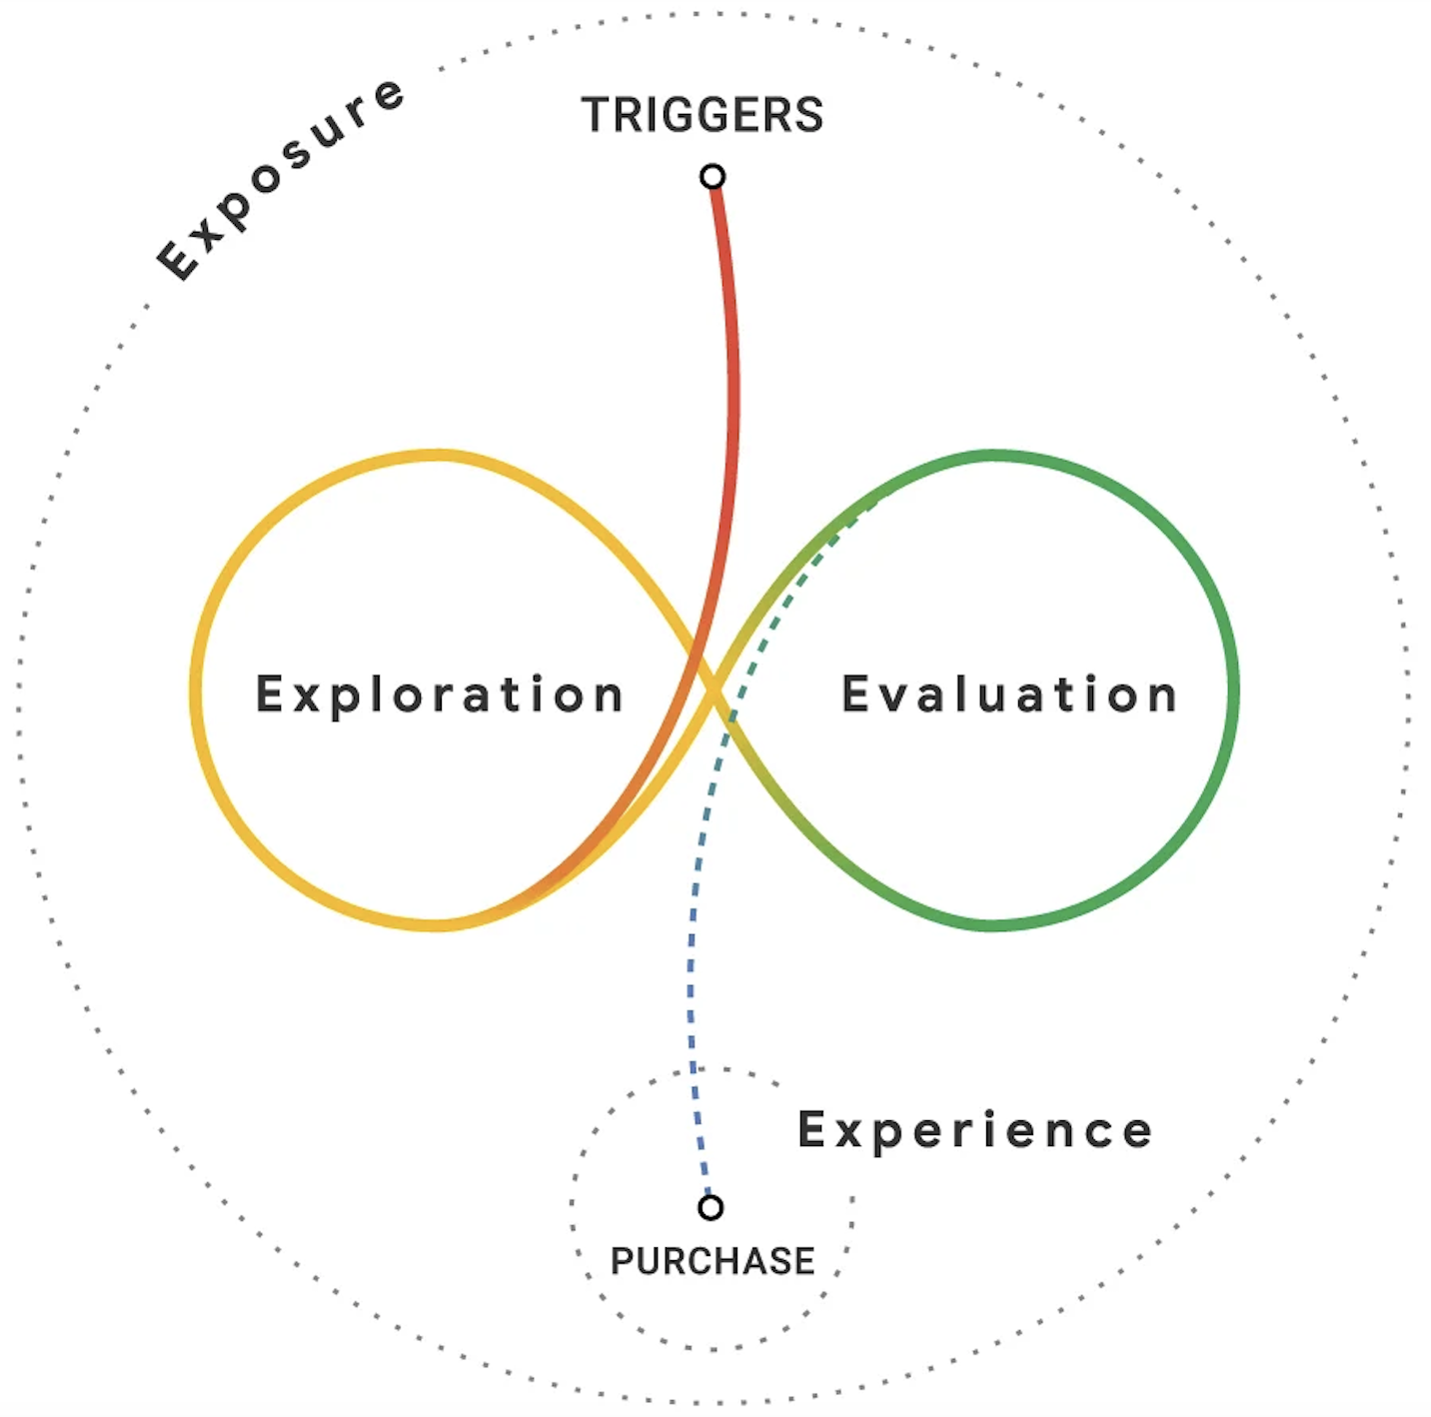
Journey Mapping
There are a lot of theories of customer journeys:
Google’s Messy Middle
Hubspot’s 4 Parts (Define, Compare, Negotiate, Select)
Forbe’s Standard 5 Steps (Awareness, Research, Consideration, Purchase, Support)
Facebook’s 3 Stages (Awareness, Consideration, Conversion)

Slide 85
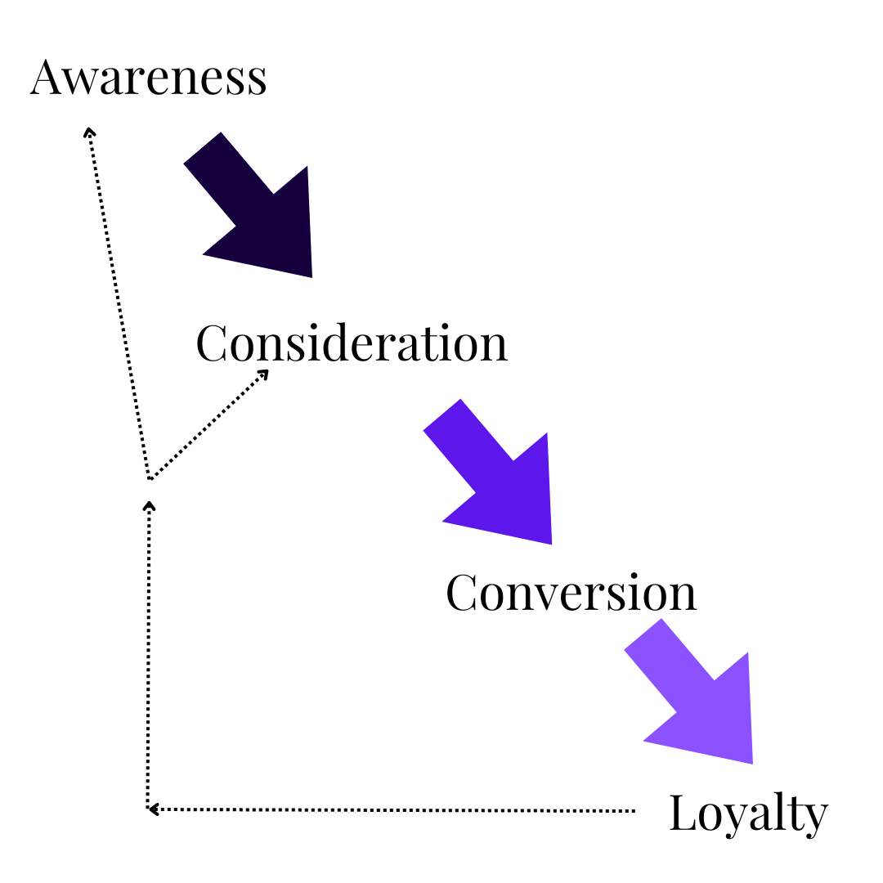
Journey Mapping
For all intents and purposes, this is the map we are going to work off of. We are going to break down all stages, phases and frameworks into four parts:
1. Awareness
2. Consideration
3. Conversion
4. Loyalty

Slide 86
Journey Mapping: Awareness
This is the stage where we simply try to reach the maximum number of ideal customers.
Ideally in digital marketing we’d consider both reach and number of new followers, because then we can see if everything we’re putting out to the internet is resonating.
In this stage, we’re using hashtags to increase discoverability, we’re engaging with new accounts, we’re encouraging followers to share our posts for us.

Slide 87
Journey Mapping: Consideration
This is the stage where we want customers to more seriously consider buying from us.
Typically people do up to three things: confirm, compare and contrast. Here we’re measuring engagement rate and direct messages.
In this stage, we’re focusing on getting and highlighting reviews, showing benefits and features in posts and honing in on what our target audience wants.

Slide 88
Journey Mapping: Conversion
This is the stage where consumers decide to buy.
Typically people take the last step or get final details to make a purchase.
In this stage, we’re focusing on posting direct links to purchase, suggesting upsells or cross sells and instilling confidence in their purchase.

Slide 89
Journey Mapping: Loyalty
This is the stage where consumers act upon a positive emotion in relation to our brand.
Typically people share and amplify the brand’s message, or make another purchase.
In this stage, we’re focusing on relatability, joy and happiness from our product or services, and encouraging shares of our posts (along with repeat purchases).

Slide 90
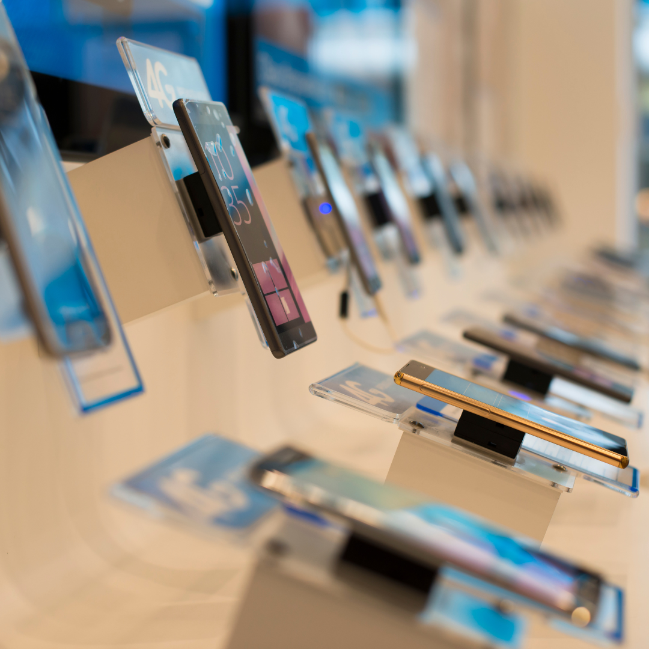
Journey Mapping: Samsung Example
Awareness: Samsung does paid ads to iPhone users who don’t even know Samsung came out with a new phone.
Consideration: Samsung highlights what the common, comparable features are between Apple and Samsung.
Conversion: Samsung posts an interactive map of stores to buy a phone with a link to a direct online purchase.

Slide 91
Journey Mapping: Samsung Example
Loyalty: Samsung does an Instagram poll asking Samsung users what their favourite phone feature is.

Slide 92
Journey Mapping: Activity
In breakout groups, you’ll be assigned a stage of the buying journey.
In ten (10) minutes, propose a post you’d do to match that part of the funnel.

Slide 93
Mapping the Customer Journey
We have target customers,
We have a funnel,
Now we need movement.
This is mapping and planning for the customer journey, which is essentially giving consumers a reason to move from one stage to the next.

Slide 94
Mapping the Customer Journey
Personal Story: I recently started earning my degree.
I learned about Athabasca University from paid ads.
I considered them though when I saw they had a variation of the Bachelor of Commerce I liked. I compared this program (B. Mgt) to other business degrees at other schools.

Slide 95
Mapping the Customer Journey
Personal Story: I ultimately decided to do Athabasca when I got details on a webpage they own that outlines how long I have to do each course, the program, and payment structures for those.
I thought about quitting, but by luck I won a contest through my university, which makes me happier to be there and to stay.
This as a journey, with movement:

Slide 96
Mapping the Customer Journey
Awareness: They found me at a time when I was looking for schools through paid ads.
Consideration: I moved to more seriously considering them by comparing their program to others, and confirming what I wanted.
Conversion: I purchased when I got what I decided was the last, and important, detail.
Loyalty: I won a contest!

Slide 97
Mapping the Customer Journey
Two key principles here:
Always have a reason to keep people moving in the funnel (the journey), and
Always have a reason for people to buy more.

Slide 98
Mapping the Customer Journey Case Study: Tim’s
Why, or what reasons exist, for people to keep buying from Tim Horton’s?

Slide 99
Mapping the Customer Journey Case Study: Tim’s
Why, or what reasons exist, for people to keep buying from Tim Horton’s?
Low price point and easy to access
Many different times and occasions we need their products
USP: ease of access and speed
When we want something sweet and delicious

Slide 100
Mapping the Customer Journey Case Study: LuLuLemon
Why, or what reasons exist, for people to keep buying from LuLuLemon?

Slide 101
Mapping the Customer Journey Case Study: LuLuLemon
Why, or what reasons exist, for people to keep buying from LuLuLemon?
Multiple outfits for cleanliness
Outfits for different types of activity
Accessories
Wear and tear

Slide 102
Easy Example of Keeping Us Buying: Technology
Why do we keep buying technology? Apply a customer journey lens.

Slide 103
Presentation & Assignment Prep Time
50 minutes to work on your presentation and hand in portions.
I will pop in to check, and you can come to the main room and check in with me.

Slide 104
Pulling it All Together: Campaigns
The term “social media campaign” is probably one of the most abused and misused terms on the planet.
What is a social media campaign?
A social media campaign is an intentional effort using online, namely social media, tools and tactics, to reach a business goal.

Slide 105
Pulling it All Together: Campaign Elements
Most campaigns will have a
Common theme, element or focal point
Business goal, with
Corresponding social media goals,
Identified tactics,
KPI’s and measurables,
Timeline and
Assets.

Slide 106
Pulling it All Together: Campaigns
Is it a campaign? York University edition:
Concept | Yes/No
Deciding to post more about professional certificate programs.
Only posting and engaging with posts that match your Black History month initiatives for February.
Crafting more posts based on social listening, where we discover more people want certificate courses, and we increase enrollment among 30–40-year-olds who want to upskill.

Slide 107
Pulling it All Together: Campaigns
Is it a campaign? York University edition:
Concept | Yes/No
Deciding to post more about professional certificate programs. | No – that’s just one thing to do, with no goal
Only posting and engaging with posts that match your Black History month initiatives for February. | No – while there’s a theme, there’s no goals or specifics.
Crafting more posts based on social listening, where we discover more people want certificate courses, and we increase enrollment among 30–40-year-olds who want to upskill. | Yes – specific, has a full plan

Slide 108
Pulling it All Together: Campaigns
Let’s review a full campaign: Made Possible By Hosts (Air BnB).
In 2018, Air BnB was struggling. They reviewed what was working well, and what wasn’t working well, according to all marketing metrics.
The one thing that was working: referral business, online and in person, from hosts.
https://www.ispot.tv/ad/bnK8/airbnb-the-first-law-of-travel

Slide 109
Pulling it All Together: Campaigns
Let’s review a full campaign: Made Possible By Hosts (Air BnB).
In 2018, Air BnB was struggling. They reviewed what was working well, and what wasn’t working well, according to all marketing metrics.
The one thing that was working: referral business, online and in person, from hosts.
https://www.ispot.tv/ad/bnK8/airbnb-the-first-law-of-travel

Slide 110
Pulling it All Together: Campaigns
How they did it:
They focused on hosts, and unique hosts or hosting opportunities
They emphasized the experience, and relied on user generated content to show Air BnB from the user experience
They prioritized and directed traffic to bookings, citing how hosts were an exciting part of the experience
They produced videos like this that emphasized hosts and user generated content
https://www.ispot.tv/ad/bnK8/airbnb-the-first-law-of-travel

Slide 111
Pulling it All Together: Campaigns
What do you think of this campaign?
https://www.ispot.tv/ad/bnK8/airbnb-the-first-law-of-travel

Slide 112
Pulling it All Together: Campaigns
For Coaching with Kyley, a campaign I may do is around a theme of Kyley will be the best friend who gets your life back.
The business opportunity we’re focusing on is relationship building to sell a service with a personal connection.

Slide 113
Pulling it All Together: Campaigns
Theme parts will include
The months of February and March,
Posts about how personable Kyley is, and
Frequent links to products, services, offers and to book her,
Tactics like paid ads, email marketing and data analysis to watch top posts, and
New selfies and action shots.

Slide 114
Pulling it All Together: Campaigns
The budget we’d then need would be
A social media manager to handle the increase in posting (who also does data reporting),
Money for the ads, and
Funds to pay an ads specialist (who also does data reporting),
A photographer for the new photos, and
Hair, makeup and rental for the space and shooting of new images.

Slide 115
Pulling it All Together: Campaigns
Let’s build a campaign together for York University!
This will be built on a Google Sheet that I will email out as a PDF after class.

Slide 116
Case Study
She came to me and asked
“How should I be using Pinterest?”
How would you answer this question?
How do you think I should have answered?

Slide 117
Presentations!
Time for you to present!
I will be marking presentations as you do them.
At the end I’ll provide generalized feedback to help you be better marketers.
If you wait until the end of the day, I can tell you your marks.

Slide 118
Day 2 Recap
We figured out how to hone in on buyer details, and which ones are most important to act upon.
We explored what people do when deciding to buy something.
We matched content ideas to stages of the buying journey.
We made sure every concept had a strategic reason, a plan, and dedicated resources.
We shared our ideas on how to set priorities and budgets for campaigns.

Slide 119
Debrief
Learning is a democratic process, and you get a hand in it too! Help shape tomorrow and future classes by sharing answers:
How were these synchronous sessions?
What can we do to make them better?
What do you need to further feel supported in this course?

